Slide 1

Quarterly Analytics

Slide 2
Twitter Highlights
Total Impressions: 900k (-3%)
Link Clicks: 1.7k (--%)
Retweets: 500 (-10%)
Likes: 1.2k (-10%)
New Followers: 329 (+2.5%)

Slide 3
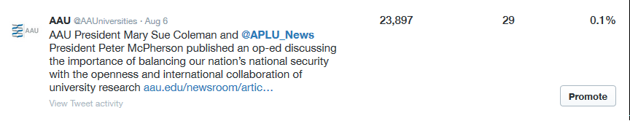
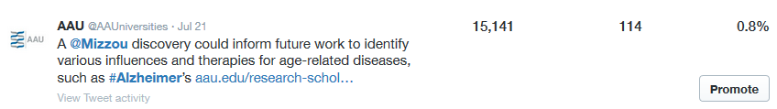
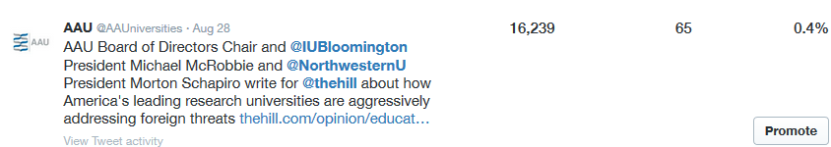
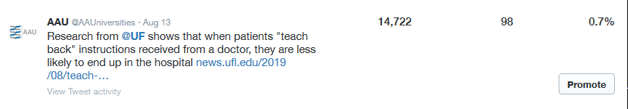
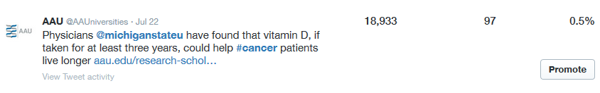

Slide 4
Linkedin Highlights
Total Impressions: 5099
Link Clicks: 67
Reactions: 105
New Followers: 37 (+6%)

Slide 5
Facebook Highlights
Total Impressions: 5288
Total Engaged (Unique) Users: 248
New Followers: 68 (+7.4%)

Slide 6
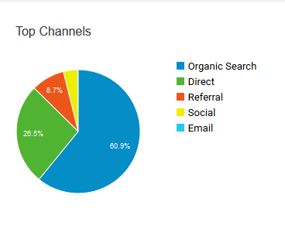
Website Analytics
Pageviews: 127,025
Users: 47,439
Bounce Rate: 61%

Slide 7
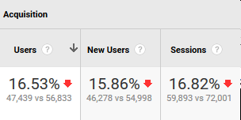
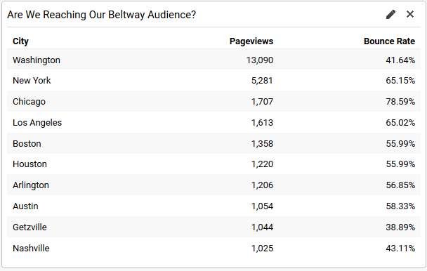
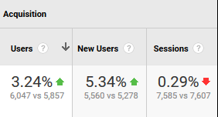
Website Analytics
All Traffic:
Referral Traffic:

